Slide 1
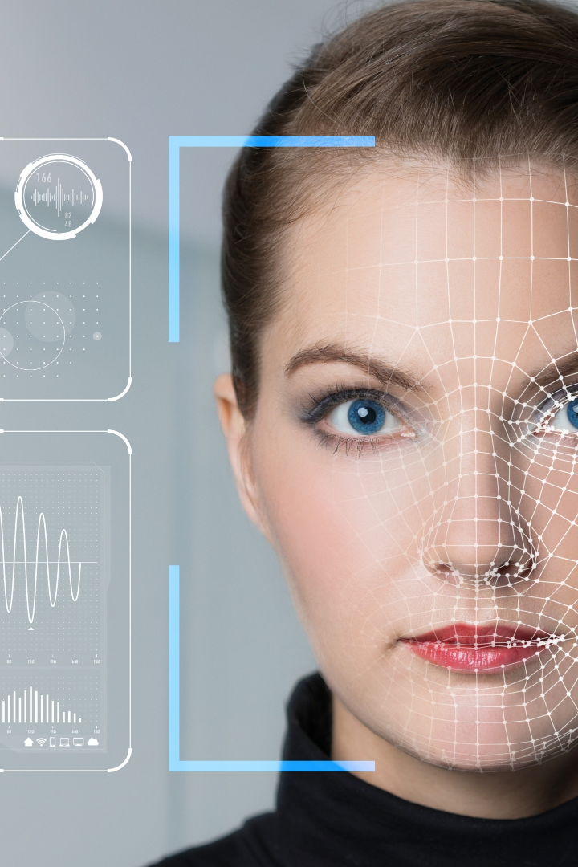
Real-Time Face Detection and Tracking System
DIPESH BHATTARAI (102217167)
SUDIKSHYA NYACHHYON (102217201)

Slide 2

Introduction
Why is Face Detection and Tracking Important?
The Evolution of Face Recognition
Real-Time Applications
The history and advancements in face detection and tracking algorithms are from traditional methods to deep learning techniques.
The real-world applications of real-time face detection and tracking includes facial authentication, emotion analysis, and virtual reality.
The significance of face detection and tracking in various fields such as surveillance, human-computer interaction, and biometrics is increasing rapidly.

Slide 3

Working Algorithm
Step 1: Initialization
Initialize the project by creating essential components, including the webcam, video player, face detector, and point tracker.
Step 2: Capture the First Frame
Capture the initial video frame from the webcam to start the real-time processing.
Step 3: Main Loop for Real-Time Processing
Enter the main loop, which continually processes video frames in real-time.
Step 4: Frame Processing
In each frame, two main scenarios are considered:
Scenario 1: Face Detection
Scenario 2: Feature Point Tracking

Slide 4
Working Algorithm
Scenario 1: Face Detection
When not enough feature points are available (fewer than 10), initiate face detection.
Utilize the Haar Cascade Object Detection for face detection.
If a face is detected, find feature points within the detected face's region using MinEigenFeatures.
Visualize the detected face with a polygon and feature points.
Scenario 2: Feature Point Tracking
When a sufficient number of tracked feature points are available (at least 10), switch to point tracking mode.
Track feature points using the PointTracker and estimate a similarity transformation.
Update the visualization to show the tracked points and the face's polygon.
Step 5: Loop Termination
Continue the loop until the video player is closed by the user or a predefined number of frames (default is 400) are processed.

Slide 5
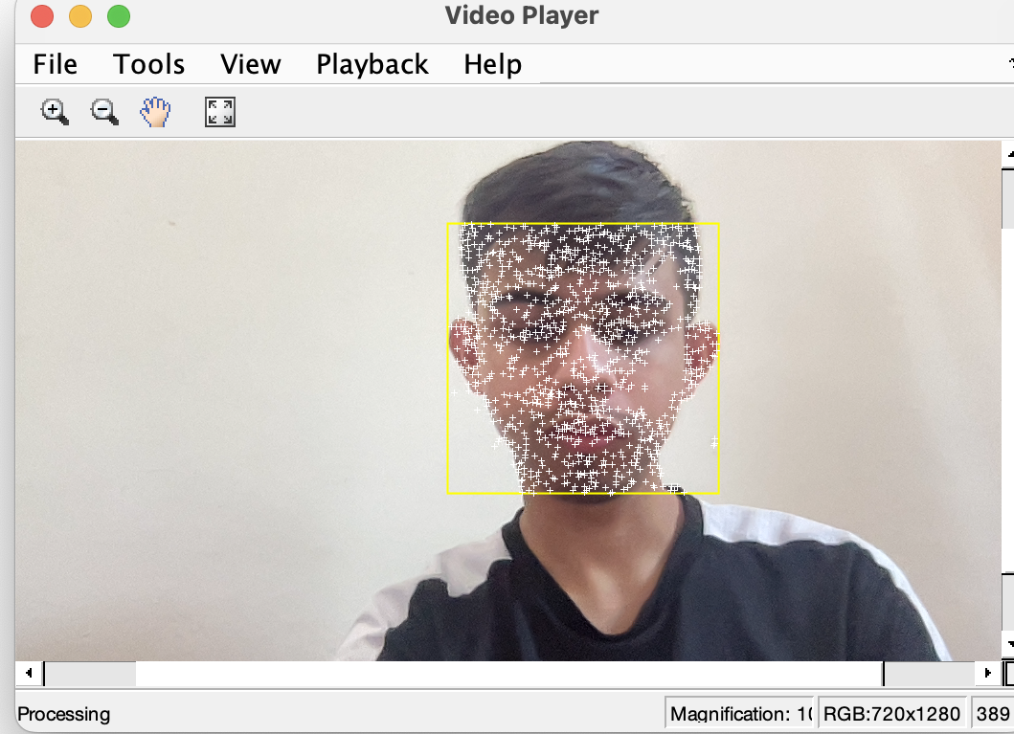
Sample Working

Slide 6

Limitations and Future Work
1
Hardware Constraints
2
Challenges in Uncontrolled Environments
Optimizing a real-time face detection and tracking system for low-end devices involves addressing hardware limitations, such as slower CPUs, limited memory, and lower-quality webcams. To enhance performance, select lightweight algorithms, downsample frames, focus on central regions of interest, implement frame skipping, parallel processing, and GPU acceleration, practice efficient memory management, and set real-time priorities.
Ensuring accurate face detection and tracking under varying lighting conditions was the problem faced during development of project.

Slide 7

Conclusion
Redefining Facial Recognition
Applications in Diverse Industries
The advancements achieved through real-time face detection and tracking systems are paving the way for future advancements in facial recognition technology.
In fields like security, marketing, healthcare, and entertainment the face detection plays a major role.
Continued Innovation and Research
Further exploration and development of real-time face detection and tracking systems should be done to unlock new possibilities and shape the future of computer vision.

